Slide 1
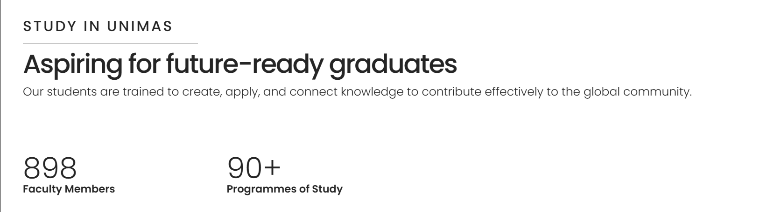
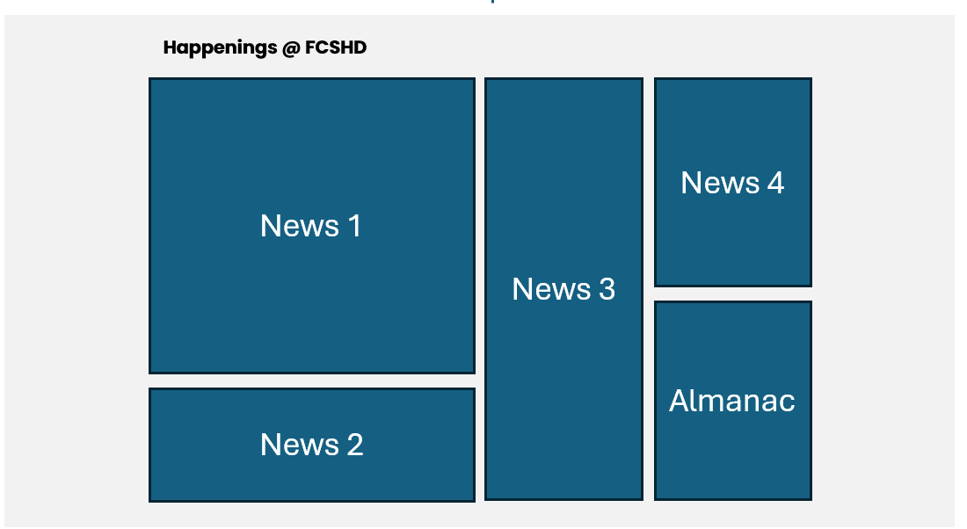
Faculty Image
ABOUT
UG
PG
RESEARCH
STUDENTS AFFAIRS
CONTACT US
DASHBOARD/ LANDING PAGE
Our Community
Human And Technology Partnership
At FCSHD, we are committed to align advancing technology with deep human understanding. Grounded in cognitive science, psychology, counselling, and human resource development, this partnership ensures that technological progress supports human growth, well-being, and ethical development in an ever-evolving world.
Undergraduate Programmes
Postgraduate Programmes
Whether you’re beginning, advancing or continuing your learning journey, UNIMAS equips you with the knowledge and skills to thrive and transform communities.
Whether you’re beginning, advancing or continuing your learning journey, UNIMAS equips you with the knowledge and skills to thrive and transform communities.
Cognitive Science
Human Resource Development
Human Resource Development (Coursework)
Counselling
(Coursework)
Counselling
Psychology
OSH
(Coursework)
By Research
Meet Our Expert
Link 4
Link 1
Link 2
Link 3
Explore Our Facilities
Link 4
Link 1
Link 2
Link 3
Quick Links
Link
Unimas gazette
Buku Panduan Pelajar
eBook FCSHD

Slide 2
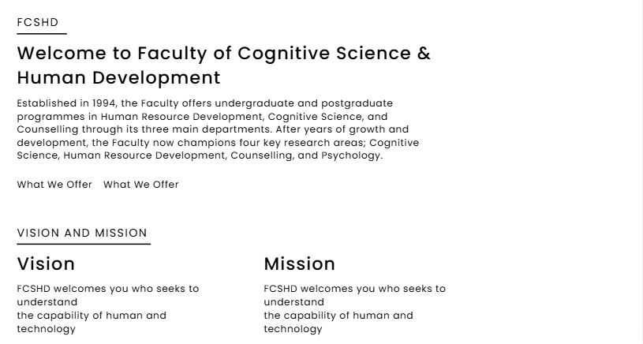

Faculty Image
ABOUT
UG
PG
RESEARCH
STUDENTS AFFAIRS
CONTACT US
ABOUT
Dean’s Note
Gambar Dekan
Our People
Ikut page lama

Slide 3

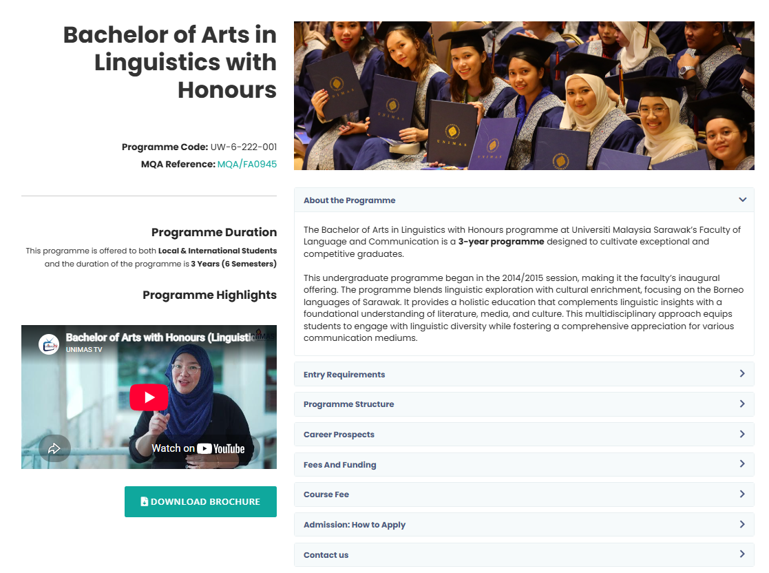
Faculty Image
ABOUT
UG
PG
RESEARCH
STUDENTS AFFAIRS
CONTACT US
UG
Ikut page lama

Slide 4
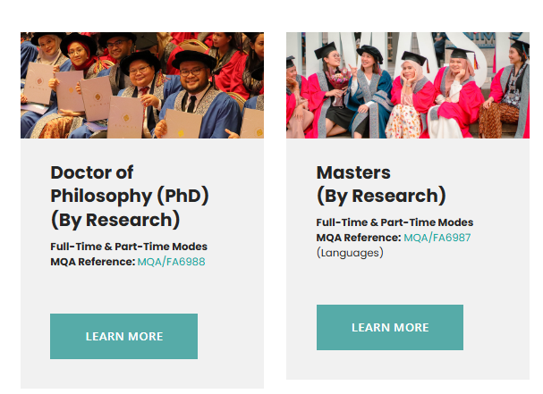
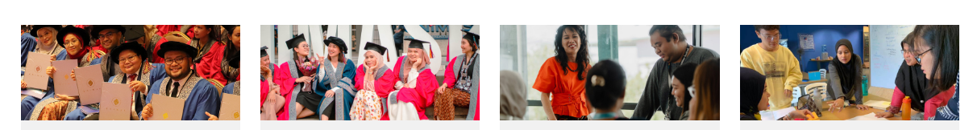

Faculty Image
ABOUT
UG
PG
RESEARCH
STUDENTS AFFAIRS
CONTACT US
PG
Postgraduate By Research
image
Postgraduate By Coursework
Ikut page lama

Slide 5
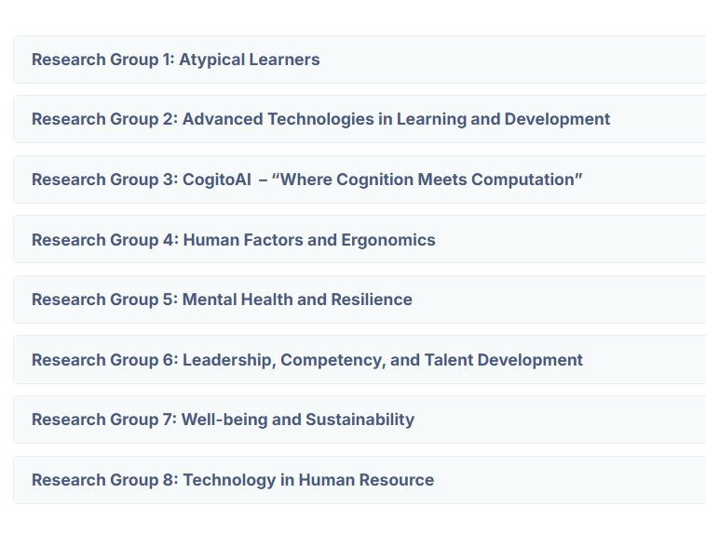
Faculty Image
ABOUT
UG
PG
RESEARCH
STUDENTS AFFAIRS
CONTACT US
RESEARCH
Our Centres
Programme 1
HRPC
Whether you’re beginning, advancing or continuing your learning journey, UNIMAS equips you with the knowledge and skills to thrive and transform communities.
Programme 2
CALW
Whether you’re beginning, advancing or continuing your learning journey, UNIMAS equips you with the knowledge and skills to thrive and transform communities.
Images
Research Niche
N 1
N 1
N 2
N 2
N 1
N 1
N 2
N 2
Ikut page lama

Slide 6
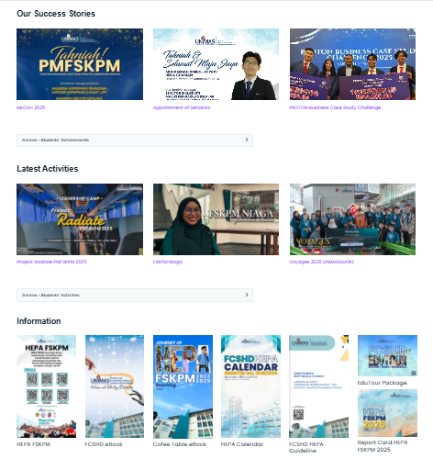
Faculty Image
ABOUT
UG
PG
RESEARCH
STUDENTS AFFAIRS
CONTACT US
HEPA
What We Do
(about hepa) Whether you’re beginning, advancing or continuing your learning journey, UNIMAS equips you with the knowledge and skills to thrive and transform communities.
What we Provide
Programme 2
FOOD BANK
(about hepa) Whether you’re beginning, advancing or continuing your learning journey, UNIMAS equips you with the knowledge and skills to thrive and transform communities.
Job on Campus@FCSHD
Programme 2
(about hepa) Whether you’re beginning, advancing or continuing your learning journey, UNIMAS equips you with the knowledge and skills to thrive and transform communities.
Students/ HEPA Images
Research Niche
Persatuan & Club

